Slide 1
Data Ethics

Slide 2
Data Ethics
The set of principles and processes that guide the ethical collection, processing, analysis, use and application of data having an effect on human lives and society
d’Aquin et al, Towards an “Ethics in Design” methodology for AI research projects, in AIES 2018

Slide 3
Data Ethics
The set of principles and processes that guide the ethical collection, processing, analysis, use and application of data having an effect on human lives and society
d’Aquin et al, Towards an “Ethics in Design” methodology for AI research projects, in AIES 2018

Slide 4
Data Ethics
The set of principles and processes that guide the ethical collection, processing, analysis, use and application of data having an effect on human lives and society
d’Aquin et al, Towards an “Ethics in Design” methodology for AI research projects, in AIES 2018

Slide 5
Data Ethics
The set of principles and processes that guide the ethical collection, processing, analysis, use and application of data having an effect on human lives and society
d’Aquin et al, Towards an “Ethics in Design” methodology for AI research projects, in AIES 2018

Slide 6
Ethics
What is right, what is fair, what is just.
Hosmer, L. T. (1995). "Trust: The Connecting Link between Organizational Theory and Philosophical Ethics". The Academy of Management Review. 20 (2)

Slide 7
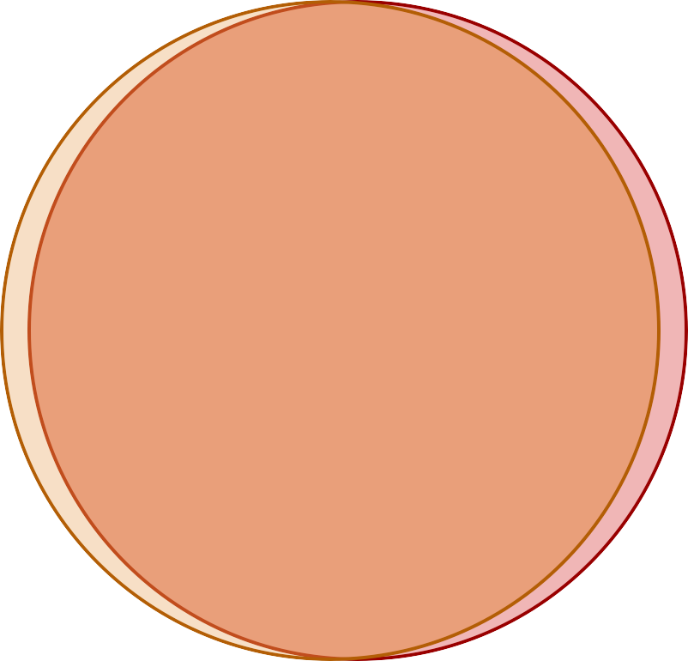
In an ideal world
What is legal. What is ethical. (right, fair, just)

Slide 8
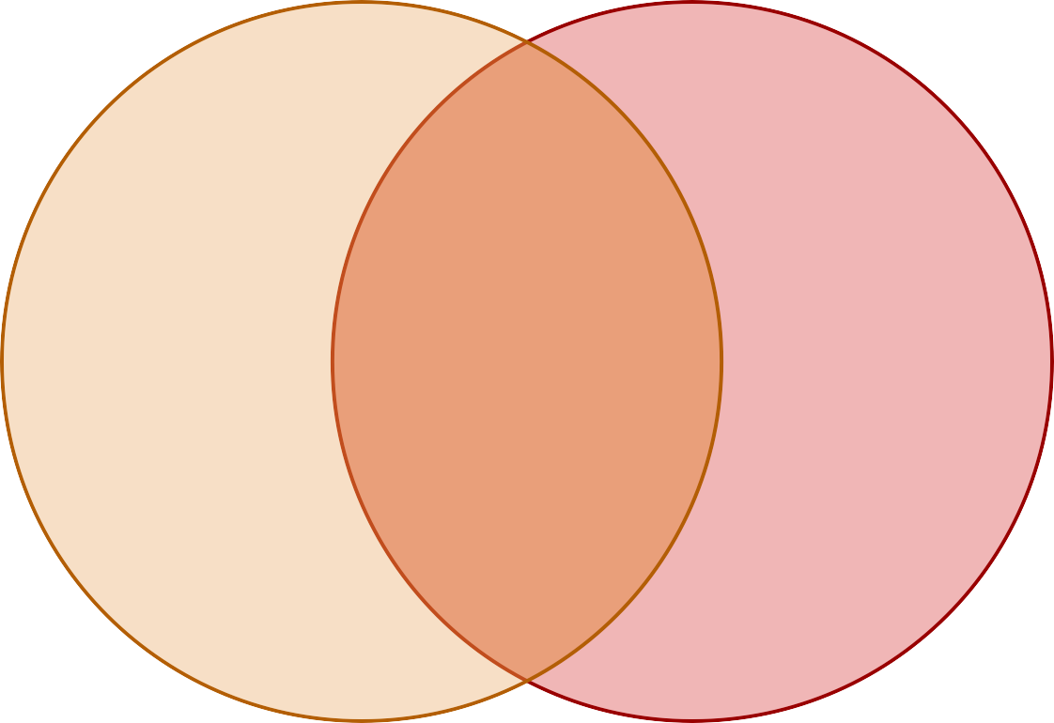
In the real world
What is legal.
What is ethical. (right, fair, just)

Slide 9



What does this have to do with data?

Slide 10
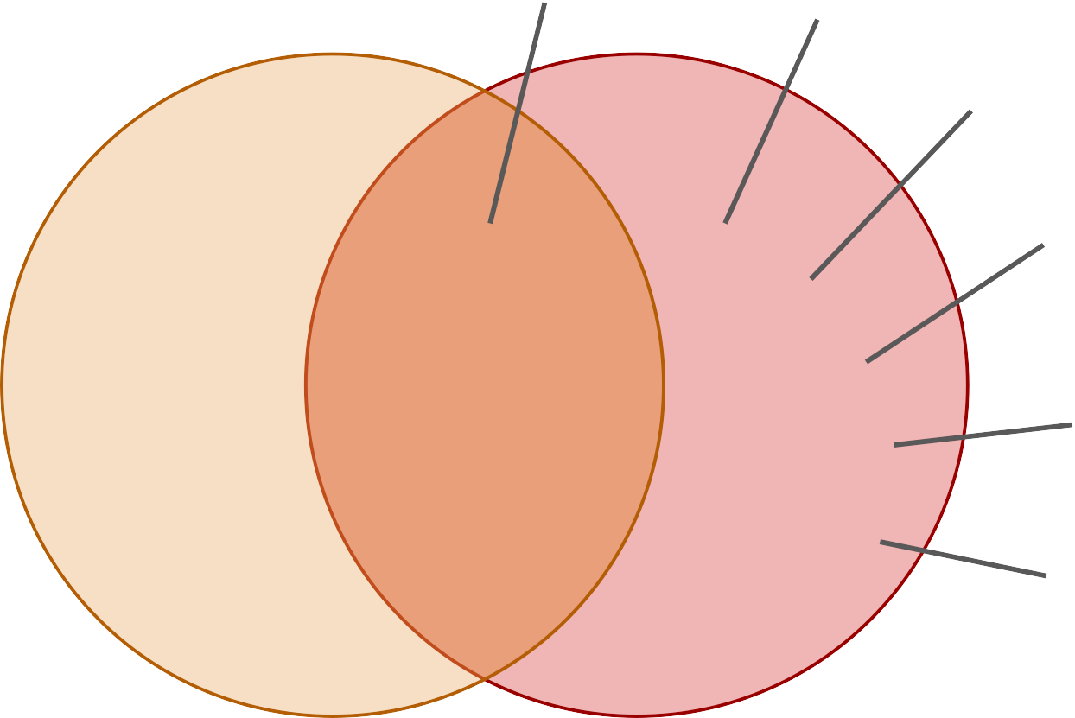
What does this have to do with data?
Data protection Privacy
Statistical bias
Black box decisions
Uneven access
What is legal.
What is ethical. (right, fair, just)
self-governance
...

